Slide 1
Devops Pipelines 1/5
Devops Easy Learning

Slide 2

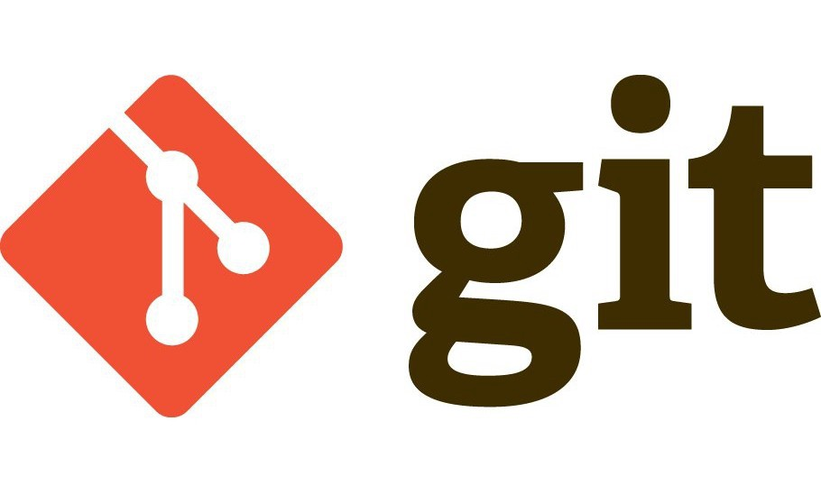
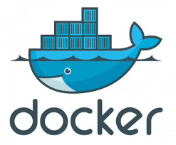
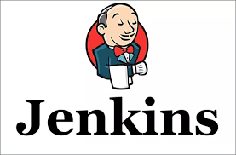
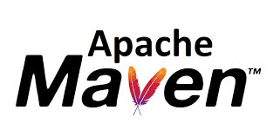



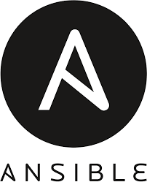
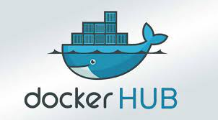

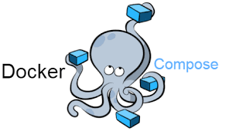
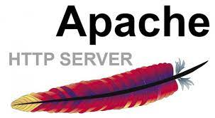
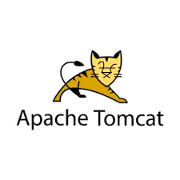
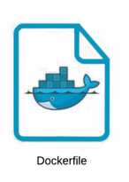

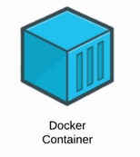
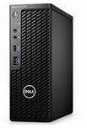

Slide 3
Problem to solve
1- Deploy two applications on a single pipeline both using a single postgres container as database
language:
- java
- html
2- use docker-compose instead of Kubernetes
3- slack notification on job failure
4- everything should be Infrastructure as a Code (IaC)

Slide 4
Lists of major files
1- Docker-compose ----- deploy all containers
2- Jenkinsfile ----------------- for main deployment
3- Dockerfile for tomcat ---------- build tomcat image
4- Dockerfile for apache--------build apache image
5- Ansible-playbook -------------- launch docker-compose

Slide 5
List tools and their functionality
Code repos
notification
Version control
Server running java application
containerization
Image repos
Image repos
Continue integration
Container management
Code report
Configuration management
Server running html application
Build tool for java code
Code analysis

Slide 6
Design a solution
We have a pipeline that is set up to build two applications, developers will write the code using java and html as language and commit that
code to github.
Jenkins is our CI tools, Maven is integrate in Jenkins as build tool, sonarqube as code analysis and testing tool.
When the PR is merged, the webbook will trigger Jenkins to pull the code
For Jenkins configuration maven and sonarqube-cli are docker containers that will only start when a Pull request is merged and once the perform the indicated task Jenkins will go ahead and terminate them and their volumes is persisted in the job workspace so that that volume can be use by other tool

Slide 7

Build the pipeline

Slide 8
explain the pipeline scenario 01
In this pipeline, once the Pull request is merged, Jenkins will clone github repository to get the latest code take the code and send to SonarQube for testing and scanning.
If the test pass, Jenkins will invoke maven to build and create an artifact.
Once the artifact is ready Jenkins will build two docker images once for tomcat and another one for httpd and send those two images to nexus and dockerhub. Once those transaction are successful Jenkins will then invoke ansible to run a playbook which main purpose to deploy to tomcat and httpd container using docker-compose.

Slide 9
explain the pipeline scenario 02
pipeline explanation 1- once the PR is merged Jenkins is triggered via predefined webhook, will clone the new code 2- start a sonar-scanner container and mount the code on that container as a volume, the sonar-scanner container will analyze the code and send the report to Jenkins and sonarqube UI 3- if the sonar scanner or sonarqube fails the build for any reason, the project will be terminated by Jenkins and the failure report will be send to slack with the build console output logs attached as a file 4- in case there is no failure Jenkins launch a maven container and also attach the code as volume in that container, maven is tasked to build the code and generate a jar file as artifact which in return is used by Jenkins to build two docker images using dockerfile already available on the repo clone by Jenkins, and once images are ready, they will be pushed to dockerhub and nexus which are both company private registry 5- once images are successfully pushed Jenkins invoke ansible which in return runs a script to update new images tag inside the docker-compose file and once that file is updated with new image tag, ansible go ahead and run that docker compose file which in returns deploy new images to tomcat and httpd servers 6- it is important to noted that sonar scanner and maven are run to completion containers, meaning they automatically killed by Jenkins once they have terminated the task for which they were call for.

Slide 10
explain the pipeline scenario 03
A month ago; I was assigned on the project where we have to setup a pipeline that will deploy two applications using docker-compose as deployment strategy. Basically, we are building a single pipeline that runs two application written in java and html. I created the repo on Github where PR’s will be merged. I configured Jenkins with webhook in such a way that Jenkins will go ahead pull the code and build it automaticallyJenkins will invoke SonarQube container for analysis scan and testing as functional test, bug test. if those code pass the quality gate that have been set up Jenkins invoke maven container that will go ahead and build the artifact, then Jenkins will build the image and push it to nexus or docker registry, and Jenkins will invoke slack for the notification. Next, Ansible will run the playbook that will launch docker compose and deploy those images in those containers which are tomcat container, apache container, and database Postgres container.

Slide 11
explain the pipeline scenario 04
so basically I setup this pipeline in such a way that whenever there is a new commit to the code , Jenkins will be notified through webhook and will pull the code .
Next, will start a sonarqube container to test the code and the report will be sent to sonarqube UI.
If sonaqube failed the job for any reason, Jenkins will mark the build as failure and a notification will be sent to slack
If sonarqube portion of the pipeline is successful meaning the code passes all quality gates and profiles Jenkins will spin a maven container to build the code and generate an artifact in tar file .
Once the artifact is ready, Jenkins build two docker images one for tomcat and another one for httpd and push both images to dockerhub and nexus both are private repo for the company
Once those images have been pushed , Jenkins will run a script to update the docker-compose file with new images tagsAfter that Jenkins will invoke ansible to deploy new images to tomcat and httpd server using docker-compose, also post the build status on slack

Slide 12
explain the pipeline scenario 05
1- For this pipeline, whenever a PR is merged on github, Jenkins will be triggered via webhook.
2- will invoke sonarqube to test and analyzed the code then send the report to sonarqube url
3- should any failure arise Jenkins will terminate the project and marked the build as failure report will be sent to slack for notification
4- assuming that sonarqube stage of the pipeline was successful, Jenkins will invoke maven to build the code and generate a warfile as artifact
5- Jenkins will build two docker images using the warfile from maven and push them to the company nexus and dockerhub repo
6- since the image tag portion of the docker-compose file was set to be dynamic meaning they are updated each time there is a new tag available via a script, Jenkins will invoke ansible witch will first run the script to update the docker-compose file with the new image tag, and then deploy those new images to tomcat and httpd server using docker-compose
7 - After that transaction a build status is sent to slack

Slide 13
explain the pipeline scenario 06
For this pipeline,once the pull request is merged in Github, Jenkins configure with webhook will automatically pull the code, test and analyse it with Sonarqube scanner.If the code passes the quality gates, Jenkins will go ahead, build it with Maven, generate an artifact in jarfile,build images from that artifact and push them in Nexux and Dockerhub. Then, Jenkins will invoke Ansible that will run the docker-compose file to deploy new images to tomcat and httpd servers once new images have been deployed, Jenkins will report the status of the project to slack.

Slide 14
explain the pipeline scenario 07
Once a PR is merged in github, Jenkins is triggered via webhook , will then clone the new the code and invoke using sonar scanner to test and analyse that code and push the result to sonar UI If sonarqube fail the code for any reason, Jenkins will marked the build as failure and send the notification to slack.
- if the code passes the sonarqube stage of the pipeline meaning all quality gates as specified in sonarqube configuration have been satisfied, Jenkins will invoke maven to build the code and generated a jarfile as artifact once the artifact is ready, Jenkins uses that to build two docker images and push those images in the nexus artifactory and dockerhub registry
- once images have been pushed, Jenkins invoke ansible to run the docker-compose file which then deploy new images to tomcat and httpd server that are running inside containers
- after images are being deploy, Jenkins send the build status to slack for notification.It is important to mention that sonar scanner and maven are on demand containers, meaning they are launched by Jenkins as needed and terminated once they have completed their task

Slide 15
Issues encounter while building the pipeline

Slide 16
Take personal notes here

